Slide 1


Inserting an element into a singly-linked list

Slide 2
Algorithm run down
Traverse the Linked list up to position-1 nodes.
Once all the position-1 nodes are traversed, allocate memory and the given data to the new node.
Point the next pointer of the new node to the next of current node.
Point the next pointer of current node to the new node.

Slide 3
public class Insert {
// A linked list Node
static class Node {
public int data;
public Node nextNode;
// inserting the required data
public Node(int data) {
this.data = data;
}
}
// function to create and return a Node
static Node GetNode(int data) {
return new Node(data);
}
Step 1:
Set a linked list call
Insert the required data
And create a function to create and return a node

Slide 4
// function to insert a Node at required position
static Node InsertPos(Node headNode, int position, int data) {
Node head = headNode;
if (position < 1)
System.out.print("Invalid position");
// if position is 1 then new node is
// set infornt of head node
// head node is changing.
if (position == 1) {
Node newNode = new Node(data);
newNode.nextNode = headNode;
head = newNode;
} else {
while (position-- != 0) {
if (position == 1) {
// adding Node at required position
Node newNode = GetNode(data);
// Making the new Node to point to
// the old Node at the same position
newNode.nextNode = headNode.nextNode;
// Replacing current with new Node
// to the old Node to point to the new Node
headNode.nextNode = newNode;
break;
}
headNode = headNode.nextNode;
}
if (position != 1)
System.out.print("Position out of range");
}
return head;
}
Step 2:
Create a function to insert node at the required position.

Slide 5
static void PrintList(Node node) {
while (node != null) {
System.out.print(node.data);
node = node.nextNode;
if (node != null)
System.out.print(",");
}
System.out.println();
}
Step 3:
Create a function to print the various outputs for the list that you want.

Slide 6
// Driver code
public static void main(String[] args) {
Node head = GetNode(3);
head.nextNode = GetNode(5);
head.nextNode.nextNode = GetNode(8);
head.nextNode.nextNode.nextNode = GetNode(10);
System.out.print("Linked list before insertion: ");
PrintList(head);
int data = 12, pos = 3;
head = InsertPos(head, pos, data);
System.out.print("Linked list after" + " insertion of 12 at position 3: ");
PrintList(head);
// front of the linked list
data = 1;
pos = 1;
head = InsertPos(head, pos, data);
System.out.print("Linked list after" + "insertion of 1 at position 1: ");
PrintList(head);
// insertion at end of the linked list
data = 15;
pos = 7;
head = InsertPos(head, pos, data);
System.out.print("Linked list after" + " insertion of 15 at position 7: ");
PrintList(head);
}
}
Step 4:
Create the program driver and set the various positions for the insert/move you’d like.

Slide 7
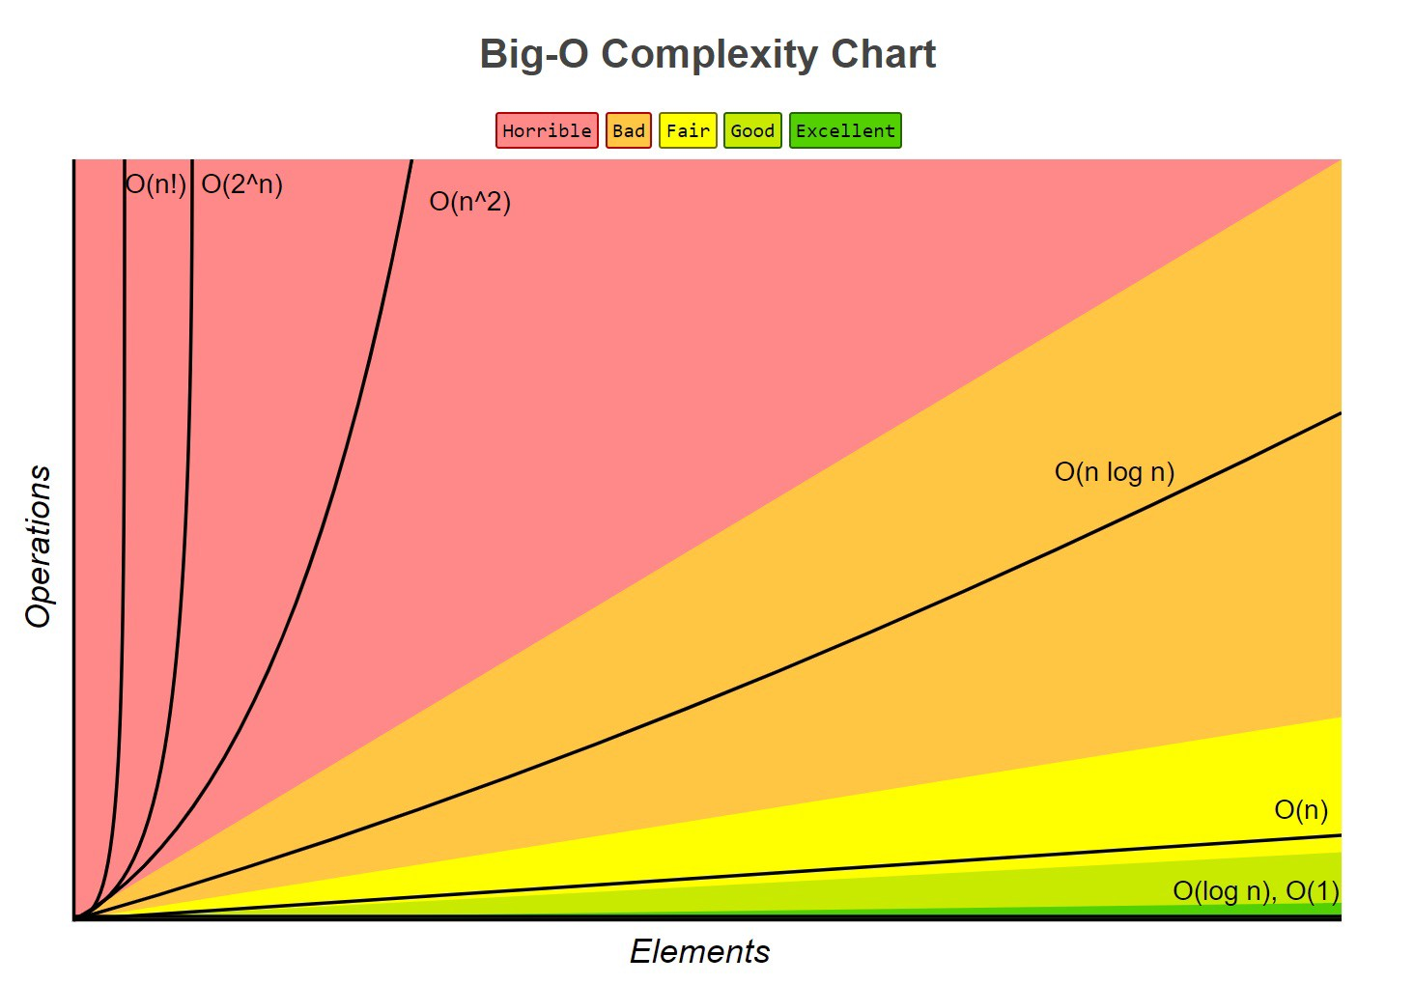
Big-O analysis:
Time Complexity
Inserting a node at the beginning of the list only involves creating a new node with an address that points to the old head. The time it takes to perform this is not dependent on the size of the list. Thus, the time complexity for this will be constant time or Big O(1).
Inserting an element to the end of the list requires traversing the whole list, then creating a new node and adjusting the previous node’s address for the next node. Time taken for this will be proportional to the size of the list and Big O(n).

